Slide 1










Rubicon Red: Cloud KickStart The best way to get started with Oracle Cloud Platform
2 Week Oracle Cloud Pilot
Benefits
Define Business Use-Case
High level scope of business transformation
Identify and prioritize business case requirements
Qualify business case with ROI metrics
Define Cloud Architecture
Define high level cloud architecture
Recommendations for the right mix of Oracle Cloud Services
Deliver Proof Point
Pilot a slice of business transformation use-case as proof-point
Share a vision of the future through working pilot
Present Business Justification
Deliver implementation plan with indicative costs and ROI
Present recommendations to business sponsors
Engage technical and business sponsors, together
Identify business benefits and cloud architecture required to support transformation
Identify required Oracle Cloud Services
Identified business case, ROI and cost to implement
Share a vision of the future with business stakeholders through a demoable pilot
Minimal investment to understand cost and requirements to implement business transformation
Notes:
With our experiences from using the Cloud Platform and already working with a couple of our own customers to get them up and running we have launched a new service.
We are helping our customers go through a rapid on-ramp to take scope out a business transformation case and determine the right cloud architecture and services they need.
We will prototype it and come up with a project plan.
We are seeing this to be a huge game changer for our customers that are serious about getting to market quickly with new services.
With the combined Oracle PaaS capabilities and our specialist Oracle product and architectural knowledge we can get some real results for customers very, very quickly.

Slide 2
















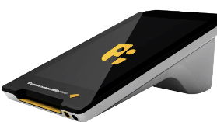

The Promise of Cloud Transformation paves the way for Innovation and Digital Disruption
Proliferation SaaS Apps
Optimal Processes @ Low cost of entry
BUT having good systems of record is NOT a game changer
Competitive Differentiation and Innovation requires …
New Business Models
New Partners
New Services
Distribution
Payments
Notes:
Thanks Vikas.
It is a very exciting time to be an Oracle partner, the rapid rate of change in terms of cloud capability you are releasing is phenomenal.
Rubicon Red specializes in integration and process management with Oracle products - we have Consulting and Managed Services offering and our own DevOps software.
For our customers cloud is a significant enabler in supporting their business transformation.
With the proliferation of SaaS apps, so readily available – our customers can pick them up and start using them so they are getting these optimal processes at a really low cost of entry, and as you said Vikas, customers are benefitting from these functional best practices that are embedded right in these SaaS apps out of the box.
But what we are seeing is that optimized BAU processes while they are improving efficiency, by themselves they are not driving competitive differentiation.
Organisations that are continually innovating and differentiating have a few factors in common:
1. Inventing new business models, and then re-inventing them
2. New partners to support those business models – payments, distribution, logistics – outsourcing parts of the supply chain to be the best they can be.
3. Introducing new services, and leveraging new technologies to re-imagine how we offer existing services – automation, devices, IoT, chatbots continually evolving to change what’s possible.
We are seeing the PaaS services evolving so rapidly, fast tracking our ability to introduce new capabilities to our clients and our own partners.

Slide 3


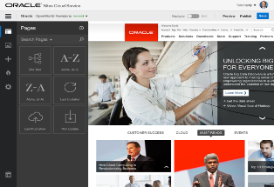

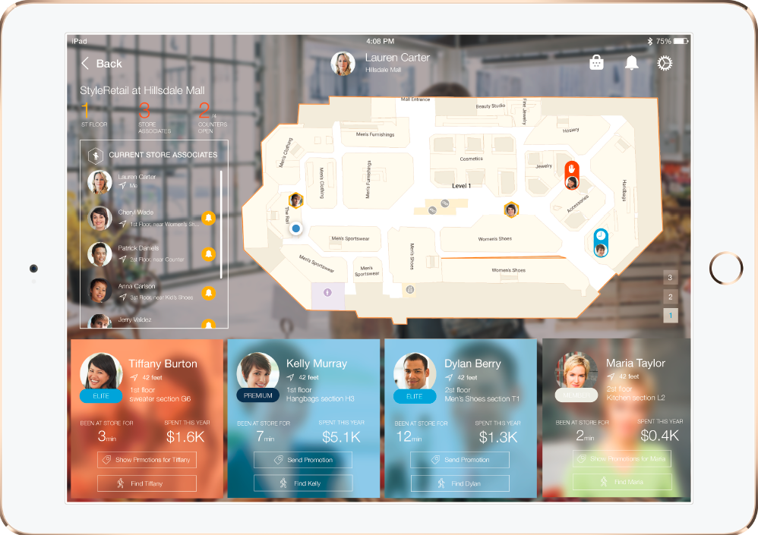
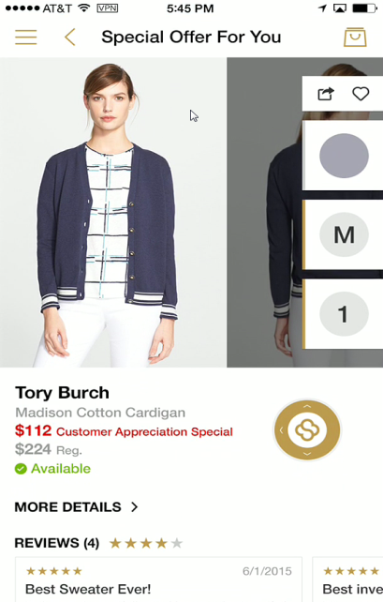









Connect and Extend SaaS Innovate and speed time to market by rapidly extending SaaS apps
Mashup/Custom UI
Mobile Access
Connected Devices
Integrated access
from any device
Process cuts across systems of record
Process Orchestration
Insulate unique
value from app
Integration & APIs
Oracle PaaS enables you to rapidly connect and extend SaaS apps.
Agility and speed to value is key for digital transformation.
Notes:
We see what underpins all of this – coming up with new ways of doing business with new partners and new services for customers – is predicated on how quickly our customers can bring together capability across those underpinning operational systems – because everything still has to touch those business cornerstones.
As you said earlier Vikas, the inovation engine is how how quickly our customers can Build new capability, Integrate and Engage.
Give the rate of change in the underlying SaaS systems and the need to still connect with the on-premise systems APIs are the key to being able to insulate our unique value from each app.
And we can cut across those independent systems of record by bringing together capabilities at the process layer by leveraging the APIs.
And with the low code automation tools available now – can build mash-ups/mobile apps very quickly.
We are seeing how effective this API-driven architectural approach is not only for our customers but also in our own business.

Slide 4
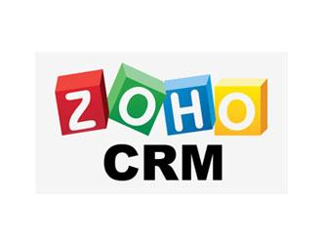
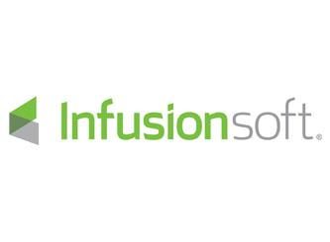
Automated Trial Request Use-Case
Process Orchestration Layer – Trial Approval Workflow
Powerful decision model and notation (DMN) feature
Integration Layer
SOACS for integration
Process layer external to CRM, provides SaaS independence (evaluating other CRM apps)
Trial approval flows are managed at PaaS layer, external to CRM.
PaaS makes it easy to extend and modify the process!

Slide 5

Automated Trial Request
Challenges / Opportunities
MyST Trial Request process was a manual, time consuming process via emails/phone calls, leads were not captured for follow-up
Wanted to improve customer response times, reduce sales workload, given increased Trial Requests
Solution Adopted
New automated PCS process to manage trial requests
Cloud-based enterprise-quality tooling, provides full life cycle process management
Integrates with Zoho CRM for end-to-end visibility for sales to follow-up with customers
Decision Model and Notation (DMN) feature to quickly qualify leads and automate approval flows
< 1
40%
Process
Cloud Service
SOA
Cloud Service
Hour vs
4 Weeks
Faster Time
To Market

Slide 6
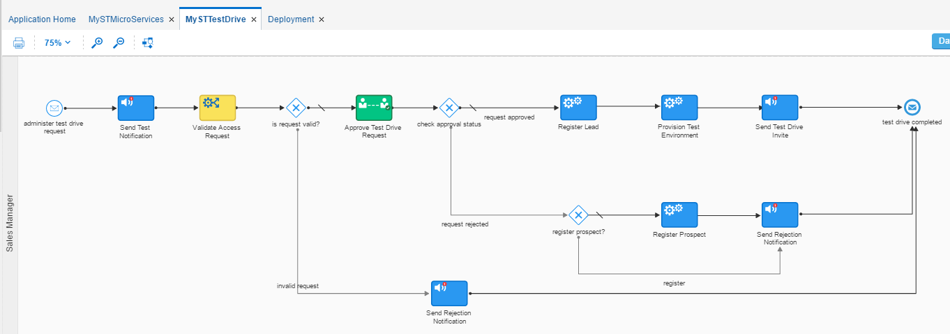
PCS MyST Trial Process

Slide 7

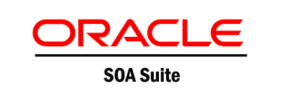
PO Consolidation Use-Case
UI Layer – Create and Approve Purchase Orders
UI designed for Mobile too
Process flow easily modified based on approval changes
Process Orchestration Layer – Approval Workflow
Integration Layer
Phased approach, on-prem SOA, consider APICS
Phased decommissioning of PO systems, migrating to JDE
PO System #1
PO System #2
Unique PO approval flows are managed at PaaS layer, external to SaaS app.
PaaS makes it fast to build and deploy, easy to change!

Slide 8


Slide 9
Rubicon Red: Cloud KickStart Cloud Services Community Project – Coming Soon

